Slide 1

Grace Pavilion Community Outreach (GPCO)
Back-2-School Report 2022
Let your light so shine before men, that they may see your good works, and glorify your Father which is in heaven. Mathew 5:16

Slide 2

Grace Pavilion Community Outreach (GPCO)

Slide 3

Grace Pavilion Community Outreach (GPCO)
Overview
Mission: Assist Grace Pavilion fulfill its call of service to people and local communities according to its vision

Slide 4
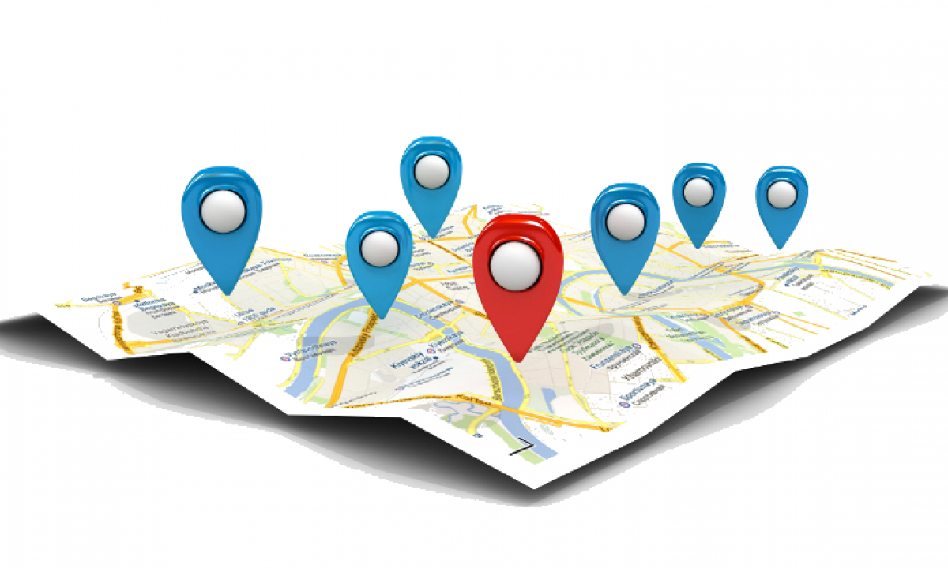
Reach
The communities we served:
San Antonio
Windcrest
Boerne
Live Oak
Selma
Universal City
New Braunfels
Schertz
Let your light so shine before men, that they may see your good works, and glorify your Father which is in heaven. Mathew 5:16

Slide 5
Reach
Service Reach:
2,040 backpacks with school supplies
450 adult care packages
650 dry food boxes courtesy San Antonio Food Bank.
350 persons received health screenings
Let your light so shine before men, that they may see your good works, and glorify your Father which is in heaven. Mathew 5:16

Slide 6
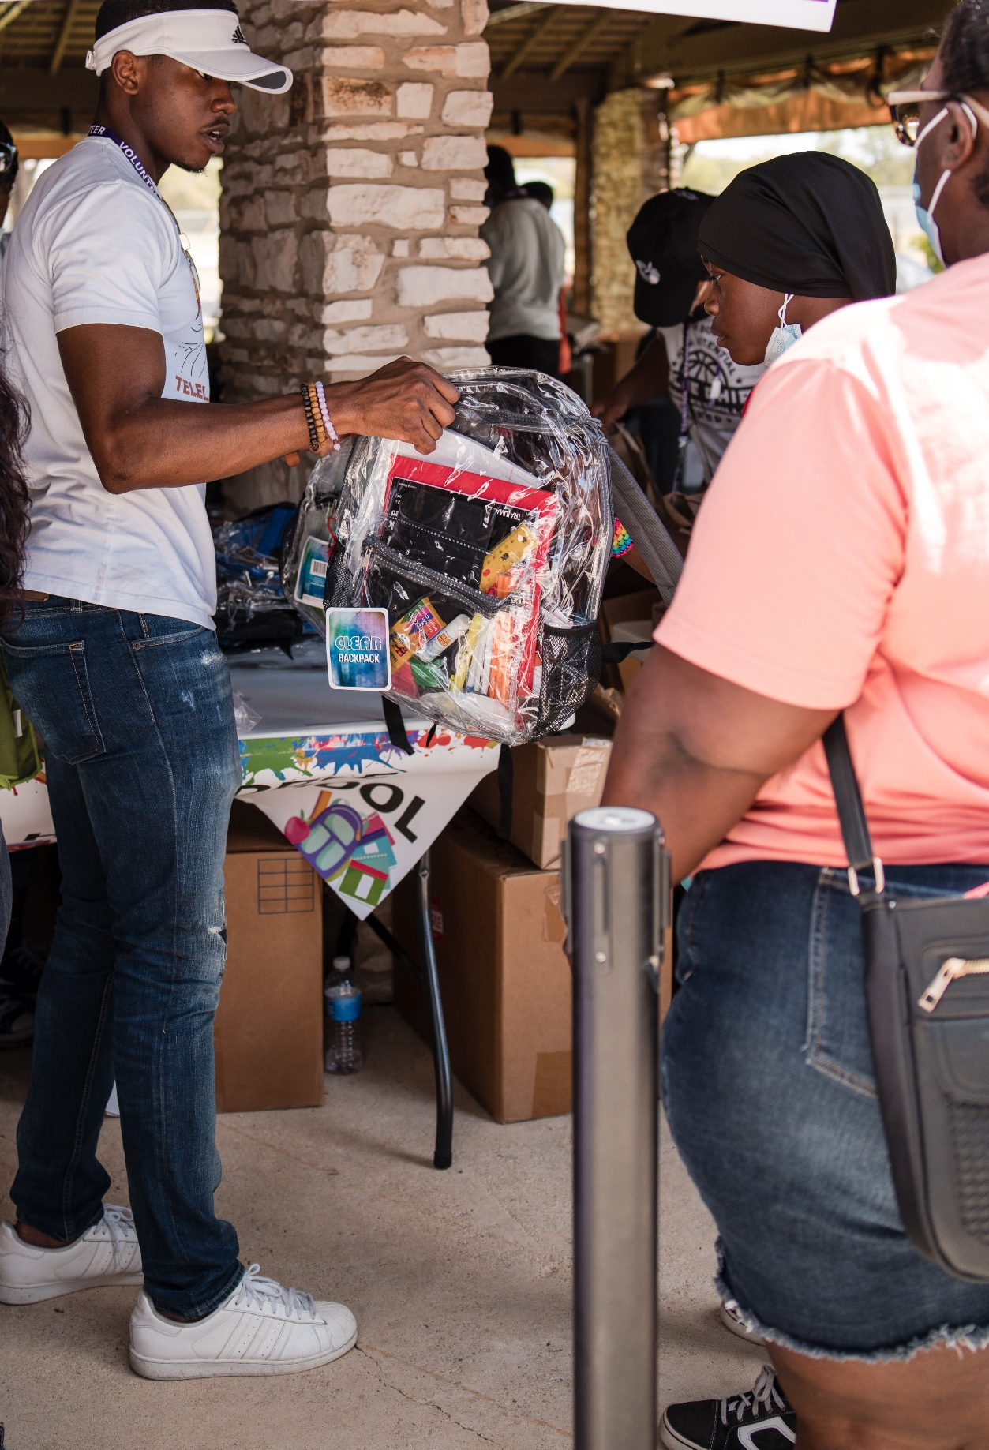
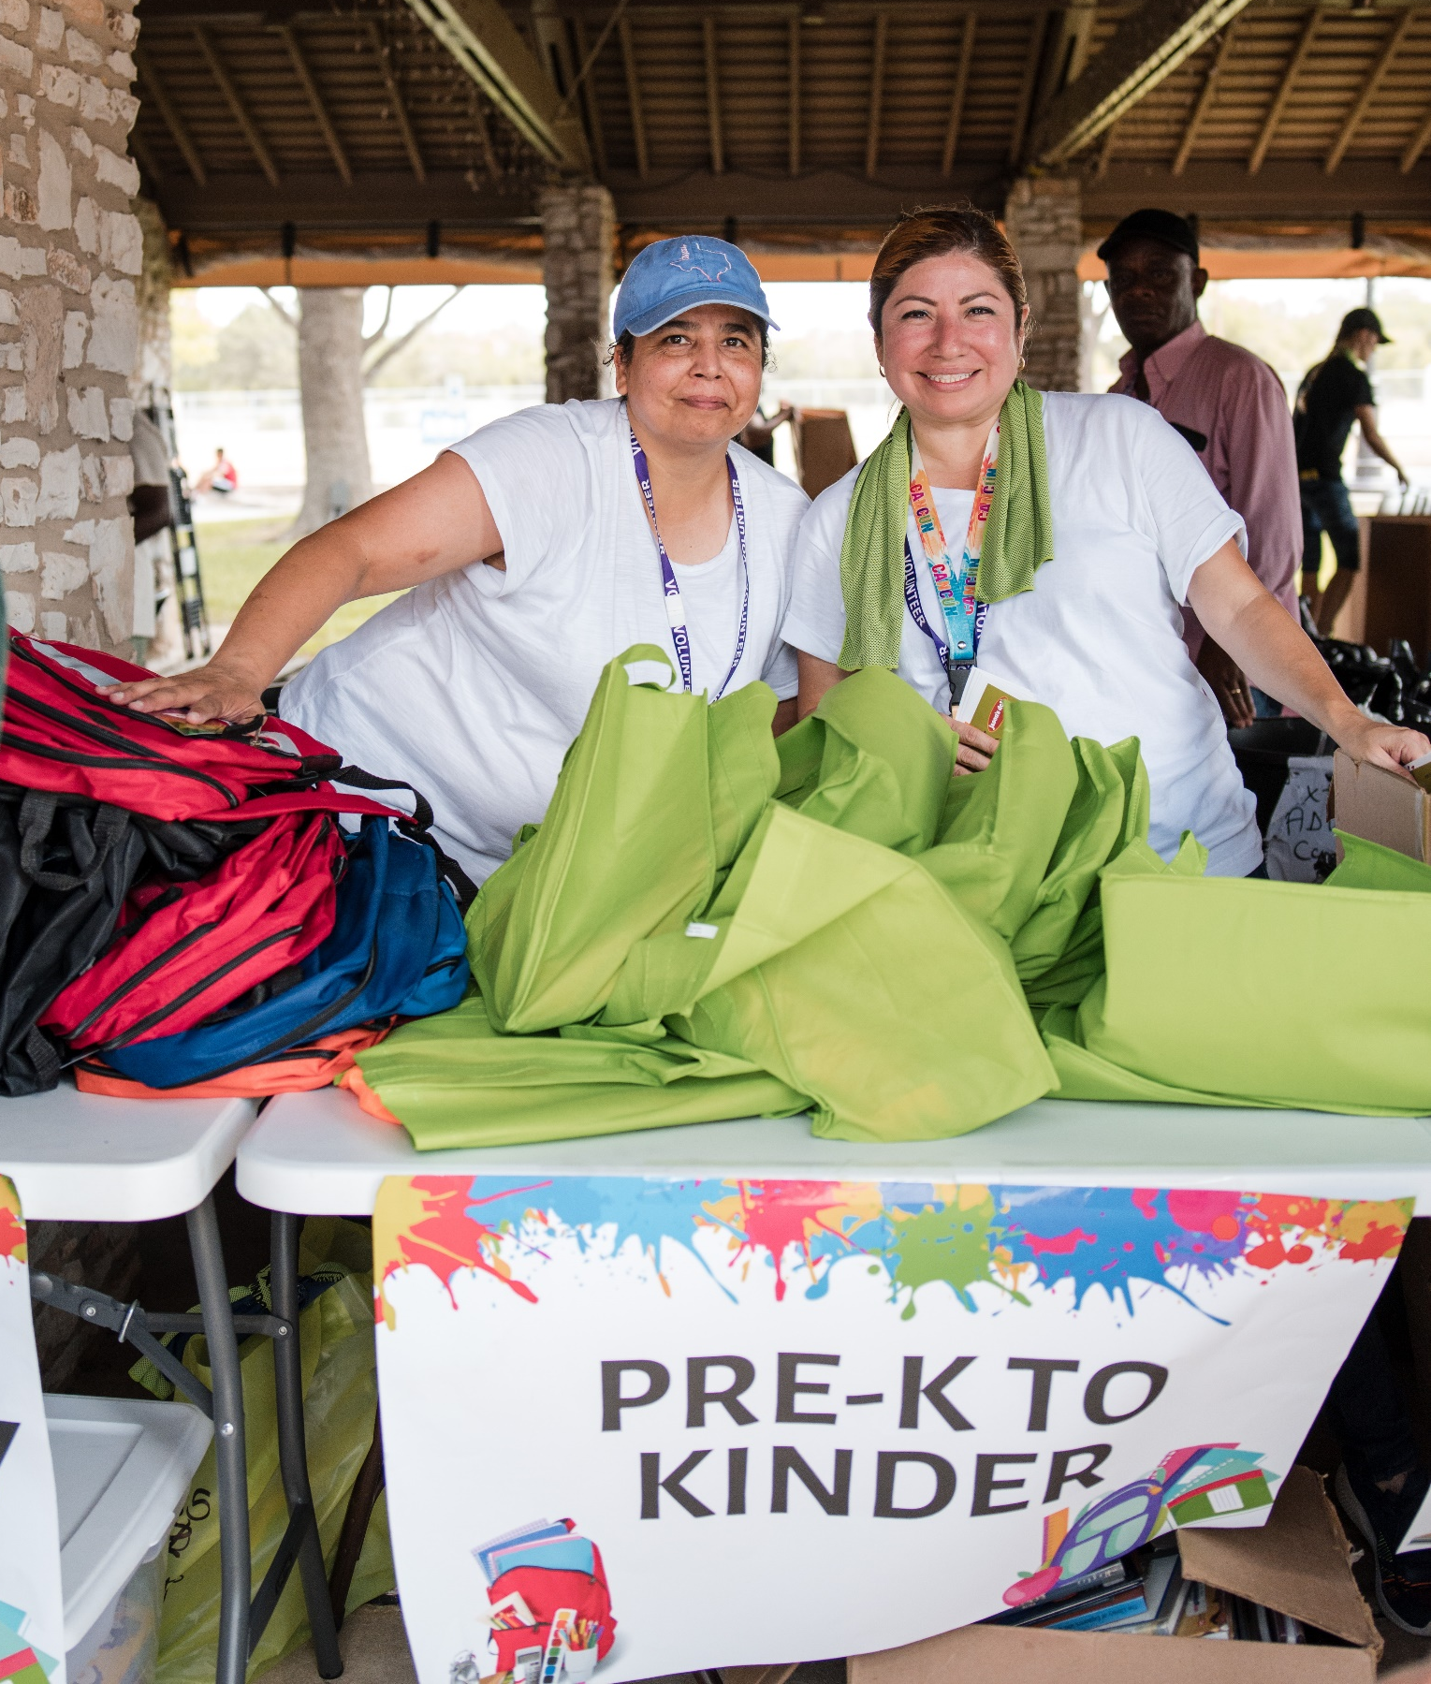
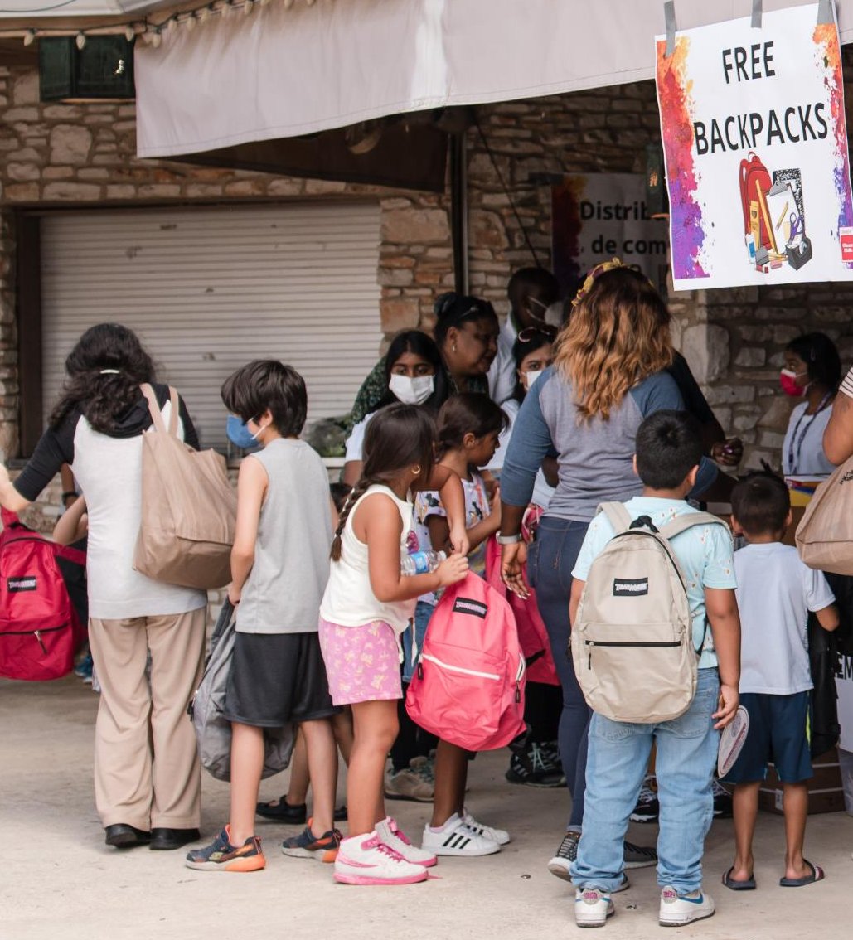
Back-2-School Event Highlights

Slide 7
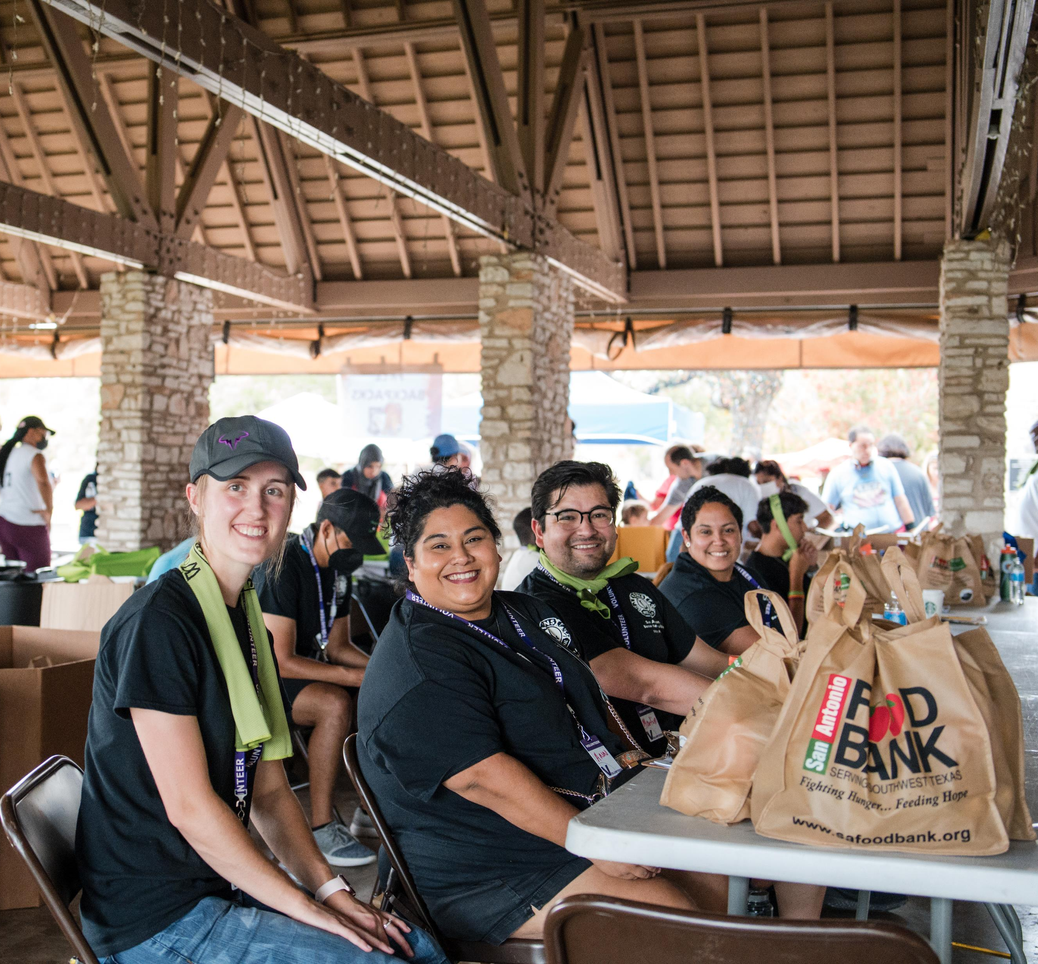
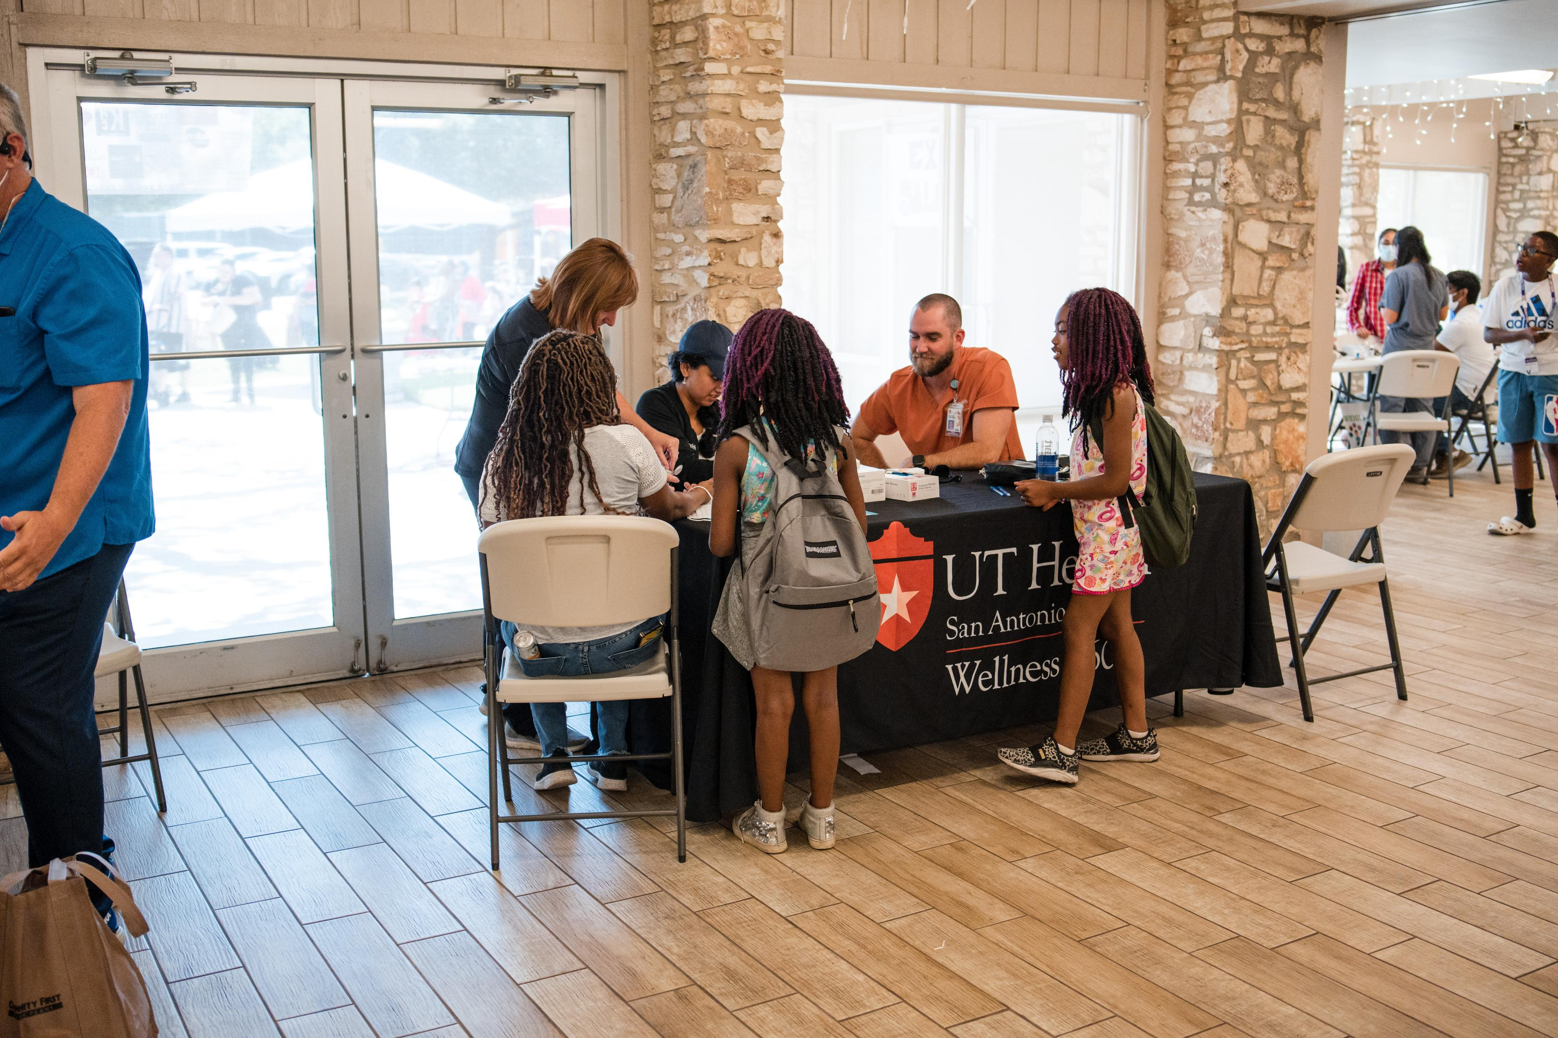
Back-2-School Event Highlights

Slide 8
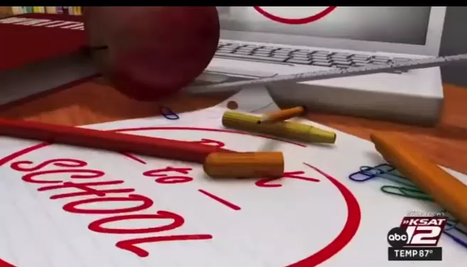
KSAT News Coverage
Back-2-School Event

Slide 9


















































Grace Pavilion Church: Health-Fair & Back-2-School Event
Saturday July 23rd , 2022 San Antonio, TX Website: www.rccggracepavilion.org
Thank you for supporting this event!

